Slide 1
^{Chapter 2} Abstract Data Types
ZAMAN UNIVERSITY
Data Structures and Algorithms

Slide 2
Outline
Stacks
Queues and Priority Queues
Linked Lists
Abstract Data Types
Specialized Lists

Slide 3
Outline
Stacks
Queues and Priority Queues
Linked Lists
Abstract Data Types
Specialized Lists

Slide 4
Doubly Linked Lists
In a doubly linked list, each link contains a pointer to the previous link as well as to the next link.
Why do we need this added pointer in each link?
A potential problem with ordinary singly linked lists is that it’s difficult to traverse backward along the list.
Consider the following statement:
pCurrent = pCurrent->pNext;
Suppose, we want to delete a link at tail. Thus, we will execute the above statement until pCurrent->pNext equal NULL.
Then we arrived tail, before removing we should set pNext of a link before tail, equal to NULL.
In this case, we cannot move back to a link before tail.

Slide 5
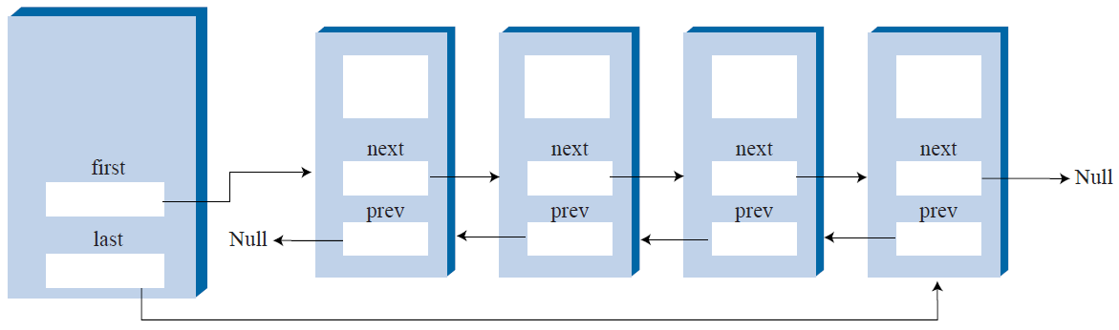
Doubly Linked List
The doubly linked list provides the capability to traverse backward as well as forward through the list.
class Link{
public:
int intiData;//Data Item
Link* pNext;//Pointer to the next link in list
Link* pPrevious; //Pointer to the previous link in list
};

Slide 6
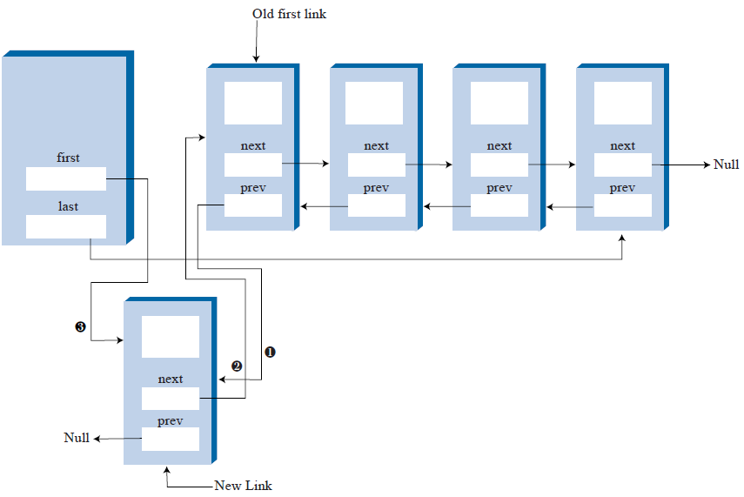
Inserting New Links
Notes:
void insertFirst(double dd) { //insert at front of list
Link* pNewLink = new Link(dd); //make new link
if( isEmpty() ) //if empty list,
pLast = pNewLink; //newLink <-- last
else
pFirst->pPrevious = pNewLink; //newLink <-- old first
pNewLink->pNext = pFirst; //newLink --> old first
pFirst = pNewLink; //first --> newLink
}

Slide 7
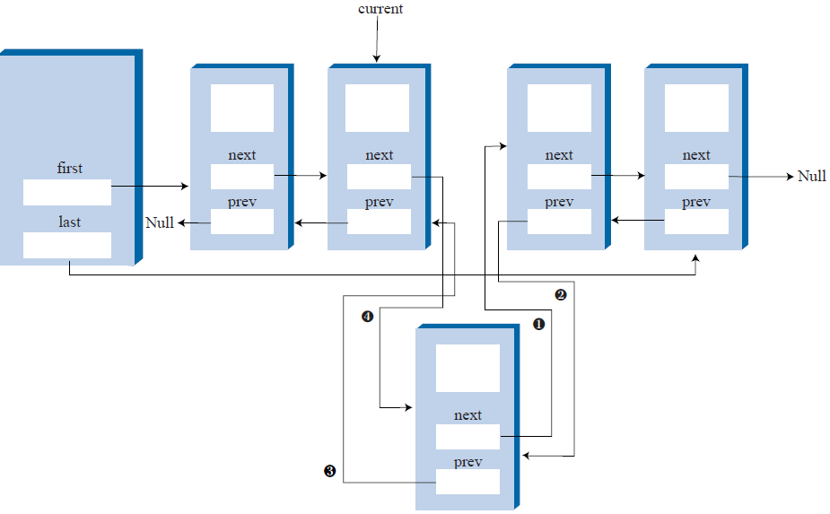
Insertion a Link at a Position

Slide 8
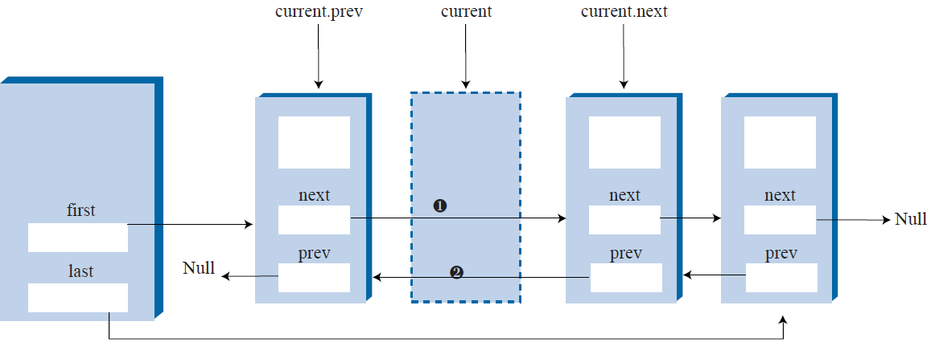
Delete a Link at a Position

Slide 9

Create Double Linked List with the following operations:
int Size() - Return number of links in the linked list
void InsertFirst(int Data) - Create a new link with Data, and insert it to the first
void InsertInThePosition(int Data, int Pos) - Create a new link with Data, and insert it to the position Pos
void InsertTail(int Data) – Create new link with Data, and insert the new list the tail of list
void RemoveFirst() - Remove the first link from linked list
void RemoveLinkInPosition(int Pos)- Remove a link in the position Pos
void RemoveTail() – remove a link at the tail of list
bool IsEmpty() – return ture – empty, else false

Slide 10
End of Chapter 2

